Slide 1
Working with Python Jenkins
Javier Salas

Slide 2
What is Python Jenkins?
Python Jenkins is a python wrapper for the Jenkins REST API which aims to provide a more conventionally pythonic way of controlling a Jenkins server. It provides a higher-level API containing a number of convenience functions.
In terms of abstraction, we will see that instead of dealing with json objects and http requests, we will deal with python objects to interact with Jenkins
Notes:
https://python-jenkins.readthedocs.io/en/latest/

Slide 3
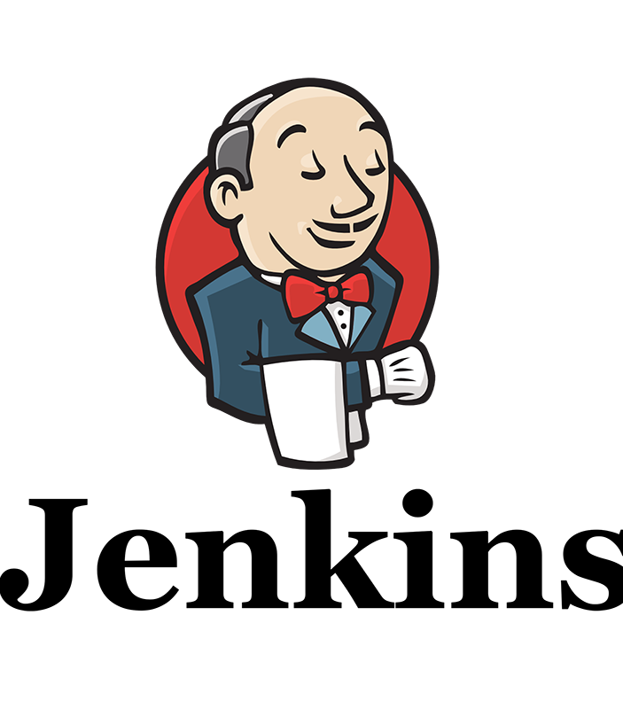
What is Jenkins?
Jenkins is a devops tool that performs tests, listens for commits, generates reports and much more.

Slide 4

Big Picture: Devops
Notes:
"a set of practices intended to reduce the time between committing a change to a system and the change being placed into normal production, while ensuring high quality”

Slide 5

Where we are in the process:
Notes:
We can see that Jenkins falls under release but it’s use also falls under testing. However, that’s not to say that Jenkins it’s restricted to what’s on this diagram. There are several applications from Jenkins and it’s extendable with other programs. For instance, Jenkins can call make to building or can have webhooks to build when one commits.

Slide 6
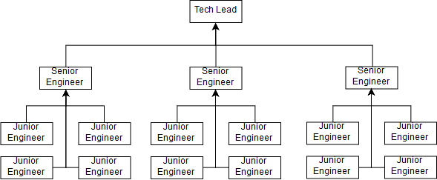
Consider the following scenario
What if you are the Tech Lead at a company and you wanted make a program to improve your organization’s programming.

Slide 7

What should the program do?
Build stability
Project progression
Unit tests
Automated reporting of errors
Report generating periodically

Slide 8
Motivating factors: CI/CD
Continuous Integration:
Test your application with every change
Detect failures as the arise
Continuous Deployment
Automate deployments
Limit risk of human error
git commit -m “a commit message”
This should do everything
Notes:
https://www.youtube.com/watch?v=WWcijE7ifcA

Slide 9
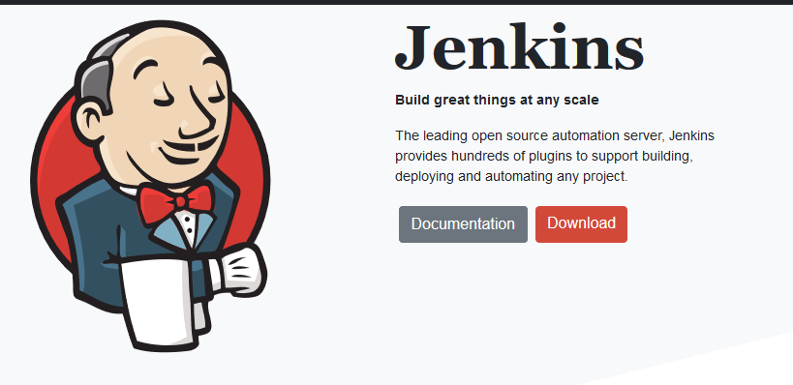
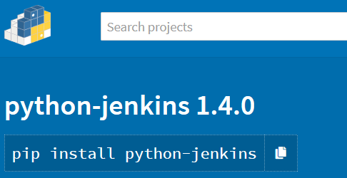
Getting started: Installing Jenkins and Jenkins-Python
Installing Jenkins
Installing python-jenkins
Download the standalone .war
pip install python-jenkins

Slide 10

Starting Jenkins
Jenkins is a Java application (.war)
java –jar Jenkins.war
Jenkins will begin a service that will let you connect to it via a web browser.
In the real world, the UI doesn’t need to be used since it’s irrelevant to Jenkin’s job
Along side a REST API, we also have a Jenkins client that can connect to the server which can send CLI commands.
Default is localhost:8080
Out of the box, Jenkins is useless, we must configure it before we can do anything.

Slide 11
Jenkins Terminology
Name | Definition
Job/Project | Refers to a runnable task that are controller / monitored by Jenkins
Build | Result of one run of a Project
Node/Slave | Slaves are computers that are set up to build projects for a master. Jenkins runs a separate program called “slave agent” on slaves. The term node is used to refer to all machines that are part of the Jenkins grid
Stable build | A build is stable if it was build successfully and no publisher reports it as unstable
Unstable build | A build is unstable if it was build successfully and one or more publisher report it unstable. A test publisher may report a project as unstable
Publisher | A publisher is part of the build process other than compilation for example, Junit test runs
Notes:
https://jenkins.io/doc/book/glossary/

Slide 12
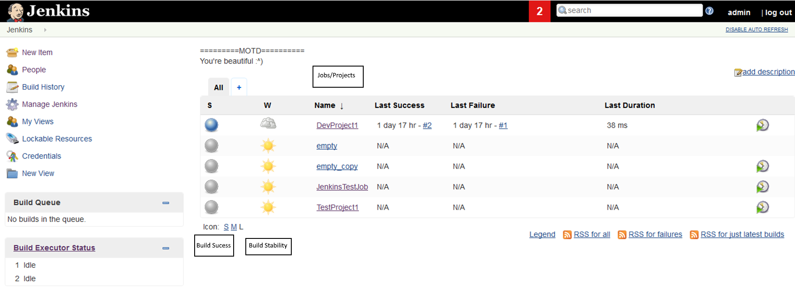
Identifying components of the UI

Slide 13
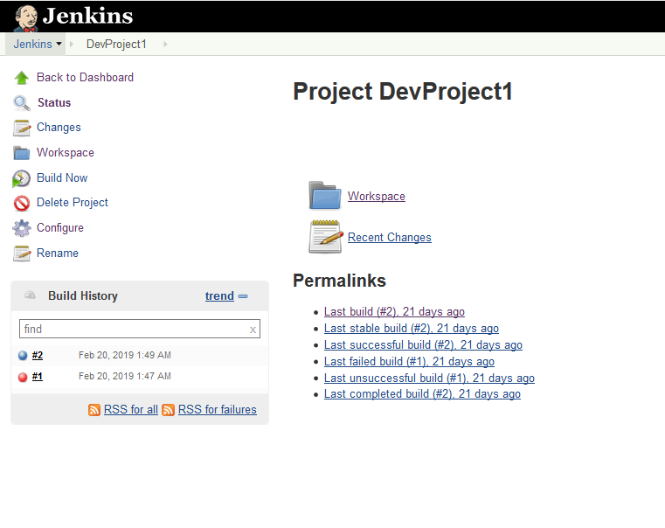
Understanding a project
Build #
Notes:
Note: build 3 should be listed here but the screenshot was taken before build 3 was made
Blue indicates a successful build while red indicates failure

Slide 14
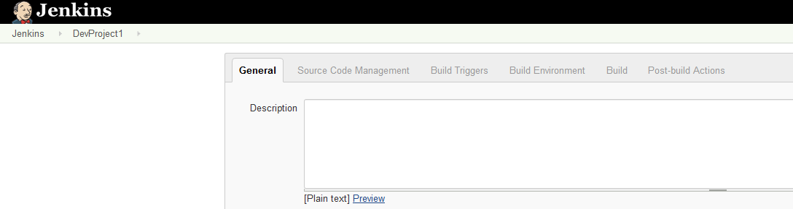
Configuring a project

Slide 15
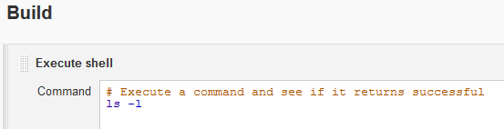
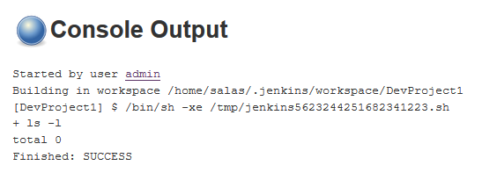
Looking at build

Slide 16
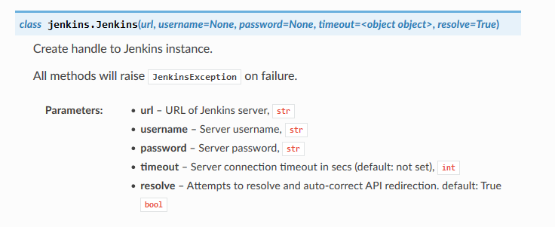
Constructor: establishing connection

Slide 17
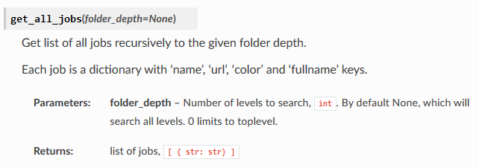
Important methods: Getting all jobs

Slide 18
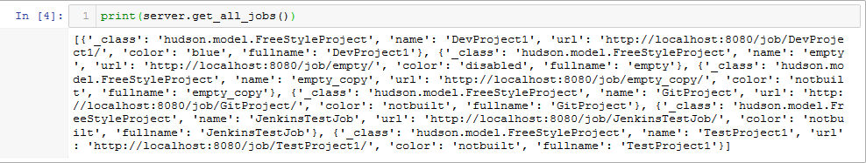
Recommended: pout
pip3 install pout
Notes:
Since Jenkins likes to return dicts, I recommend using pout for pretty printing

Slide 19
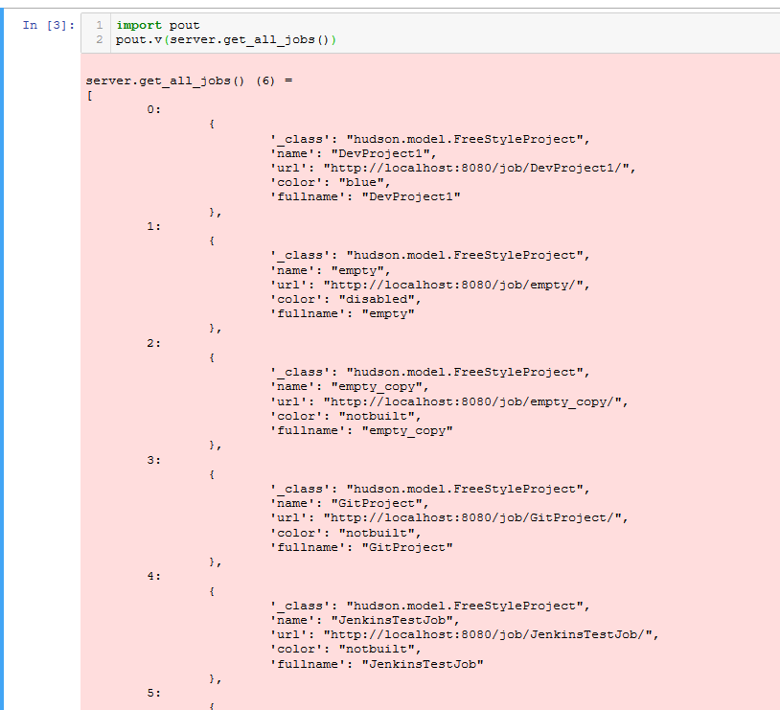
Recommended: pout

Slide 20
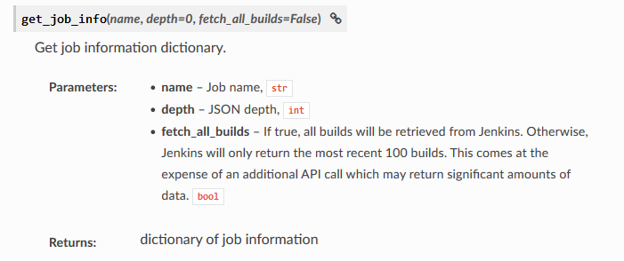
Important methods: Getting job info

Slide 21
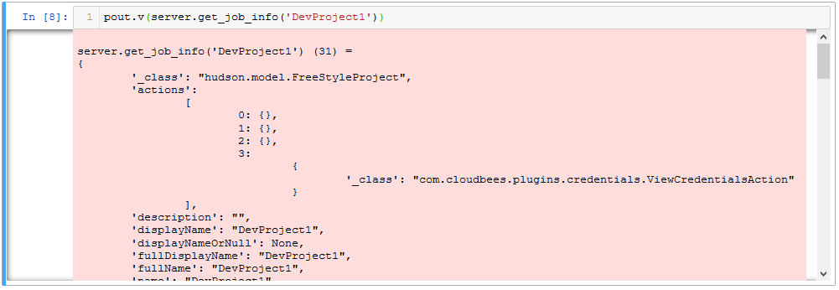
Example: getting job info

Slide 22
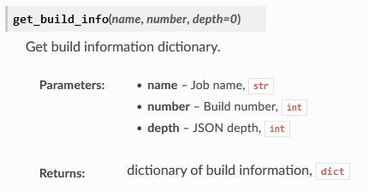
Important methods: Getting build info

Slide 23
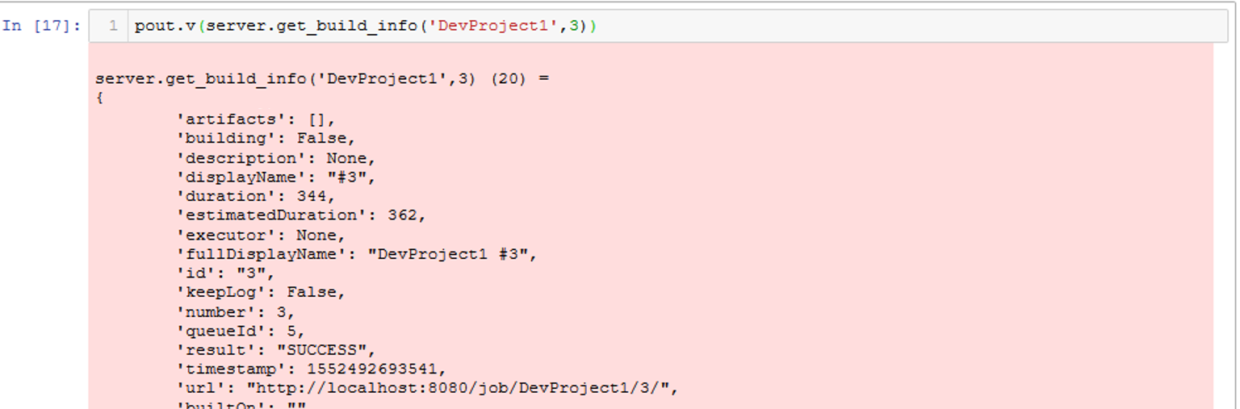
Example: getting build info

Slide 24
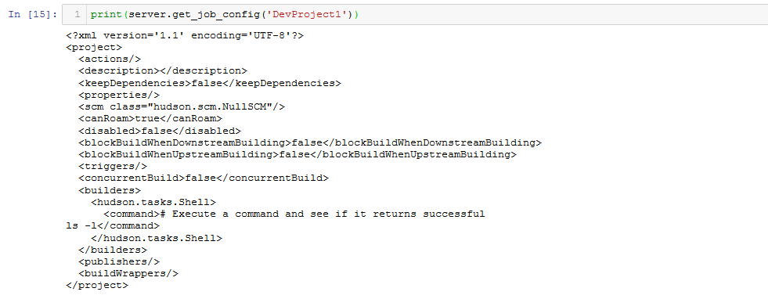
Important methods:

Slide 25
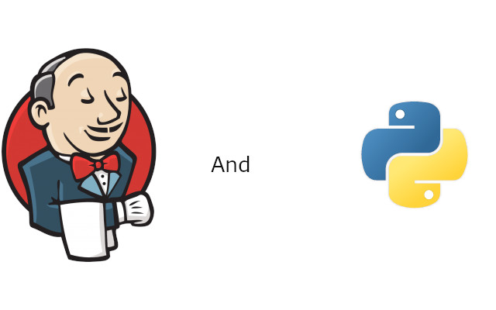
Jenkins and Python
Using Jenkins, we can run nosetests. By configuring Jenkins to convert the output of nosetests into to an xml file we can process it as a Post-Build Action.
We can also use pylint for checking our style.

Slide 26
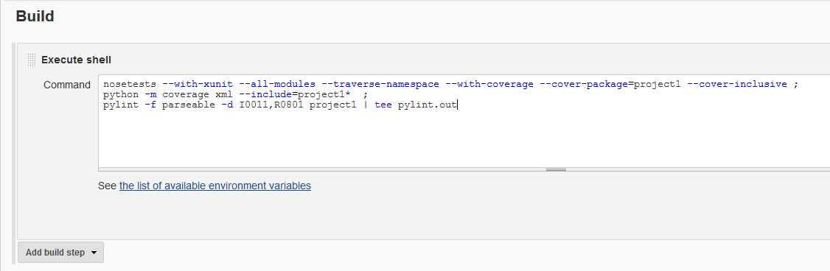
Building: using nosetests and python
After installing nosetests and pylint on the machine. Install the Jenkins Cobertura Plugin (for nosetests) and Jenkins Violations (for pylint)
Notes:
PYTHONPATH=''
nosetests --with-xunit --all-modules --traverse-namespace --with-coverage --cover-package=project1 --cover-inclusive
python -m coverage xml --include=project1*
pylint -f parseable -d I0011,R0801 project1 | tee pylint.out

Slide 27
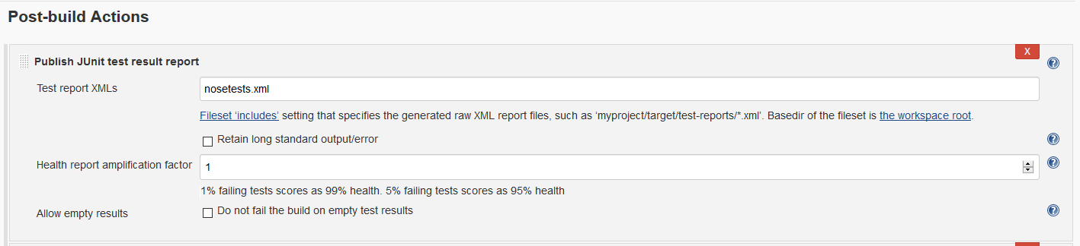
Post-build action: nosetests
When nosetests runs the code coverage, it generates a .coverage file. Jenkins can't read that. The second line of the script (python -m coverage xml...) converts the .coverage file to an xml format that Jenkins Cobertura plugin can read.

Slide 28
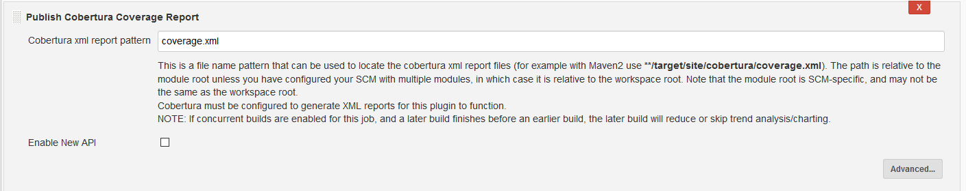
Post-build action: pylint
The last line (pylint...) runs pylint on the project and outputs it in a format that the Violations Jenkins plugin can read.

Slide 29
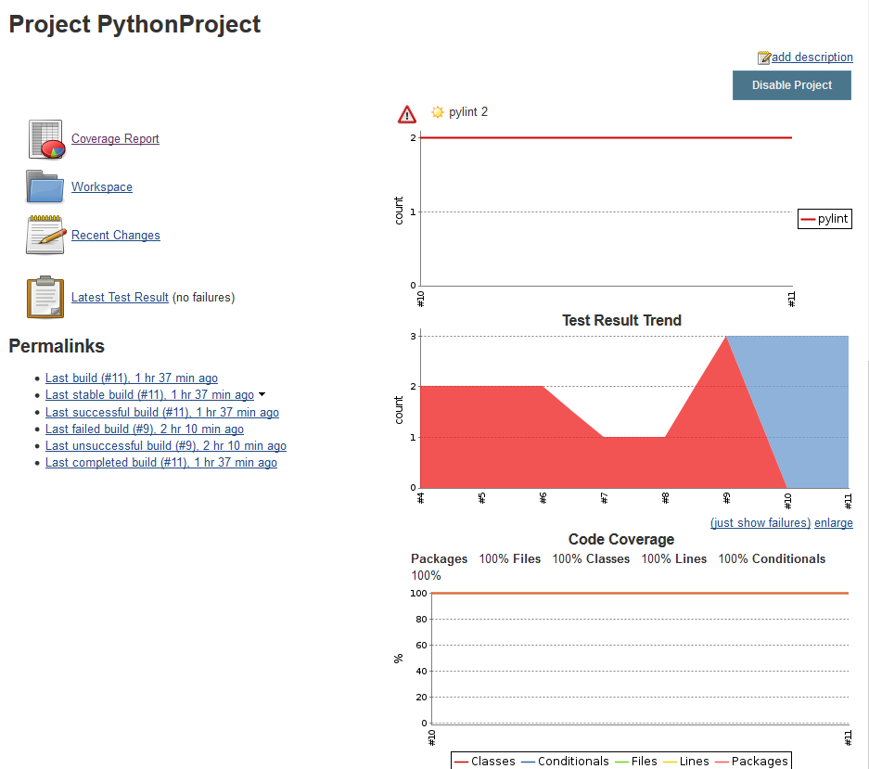
Looking at the results of our new build
Notes:
Here we can see the top graph represent the pylint error count.
The Test Results Trend shows the trend of the build status.
Code coverage shows us what percent of our functions have tests

Slide 30
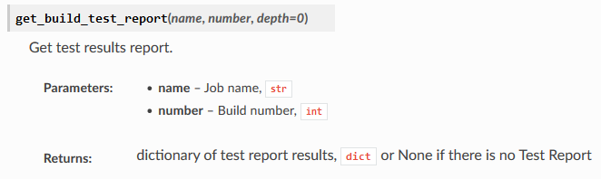
Important methods: Getting build test reports

Slide 31
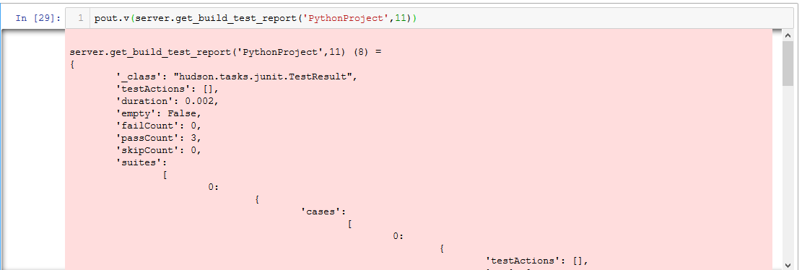
Example: getting test reports

Slide 32
Putting it all together:
Creating a new Jenkins project from existing source code
executing ‘python script.py’ – This script will do the following:
Installs Jenkins Plugins
Set the git path to cwd by replacing the git element using xpath
Starts a build
Prints the build’s debug info

Slide 33
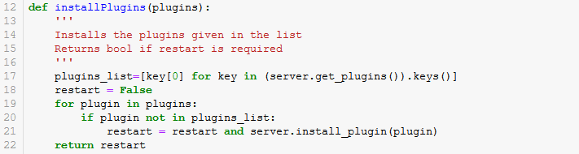
Installing Jenkins Plugins

Slide 34
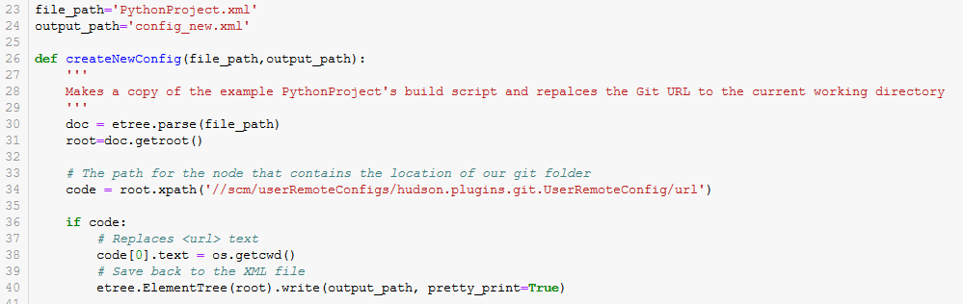
Replaces the git element using xpath

Slide 35
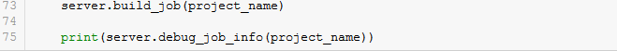
Start a build and print debug info

Slide 36
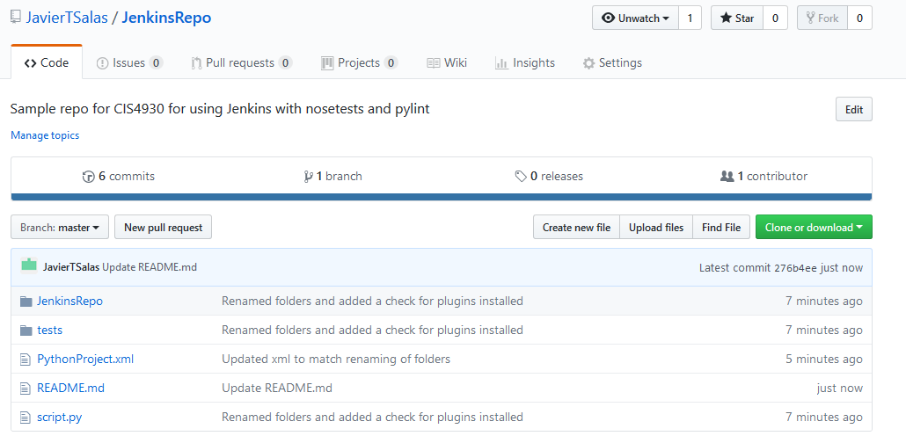
Try it for yourself

Slide 37
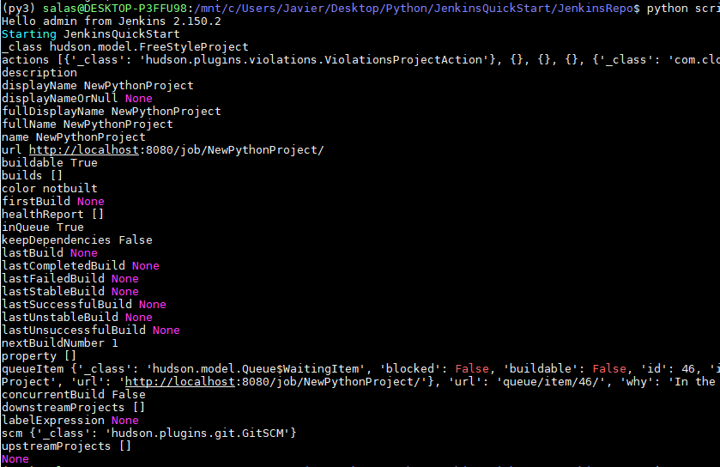
Try it for yourself

